Slide 1
Ms. Pruiett
Selfometry
Sample

Slide 2

Right angle
The edge of the picture is a right angle. The sides meet at 90 degrees.

Slide 3
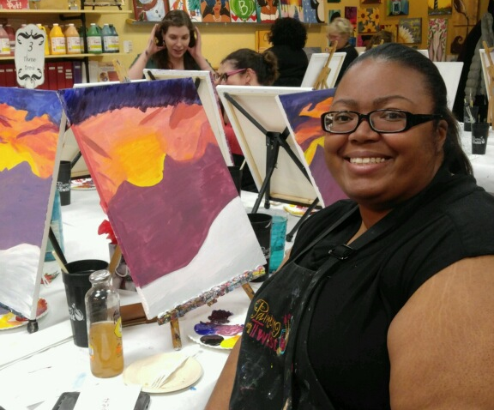
Opposite Rays
The edge of the picture forms a straight angle or 180 degrees

Slide 4

Obtuse Angel
The angle of his arm is greater than 90 degrees but less than 180 degrees so it is obtuse

